Slide 1
Pet Motion Tracing
ECE532 Digital System Design
Team #11
JIaqi Tian 1000263546
Wenyu Mao 1000822292
JIayi Xu 1000375015

Slide 2
Introduction
Monitor
Background subtraction
Motion tracing
Path generation
Trace
Analyze

Slide 3
Initial Goals
Real-time motion tracing: object detection & path generation with background subtraction algorithm.
Hot zone image generation.

Slide 4
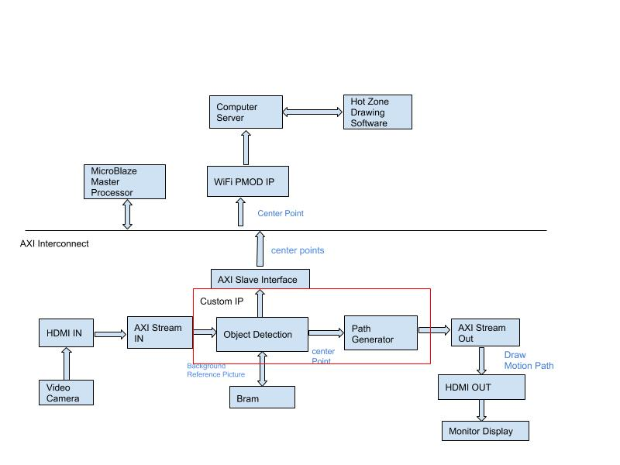
Block Diagram

Slide 5
Challenges
Not familiar with tools and design process
Spend a lot of time on simulation
Timing fix
Debug strategy: SDK or hardware debugger
Limited time: no time to try more alternatives
Takes much time on integration
Integrate C and C++ project
Limited resources of NEXYS video board.

Slide 6
Results
Object Detection
Line drawing
WIFI implementation

Slide 7
Design Process
Road To Success
Management
Milestones to separate work reasonably for each week
A large part of design always divide into smaller pieces and test each pieces to make sure every part works
Try to apply knowledge learned from assignments (eg. DSP block to solve timing)
Keep in touch with TA actively for uncertain issues
Having two people mainly working on the core algorithm and one person working on peripheral blocks
Even workload for every team member
Constant communication
Set internal deadlines

Slide 8
Lessons Learned
There is a trade off happens between the difficulty of peripherals and core algorithms
Consider resource limits before planning the design
Coding in a reasonable way to avoid solving timing issues
Start as early as possible
Strictly follow milestone, any delays will be problematic

Slide 9
Project Demo

